Slide 1
Calliwriting
박이경(조장)
김동희
Team 9

Slide 2
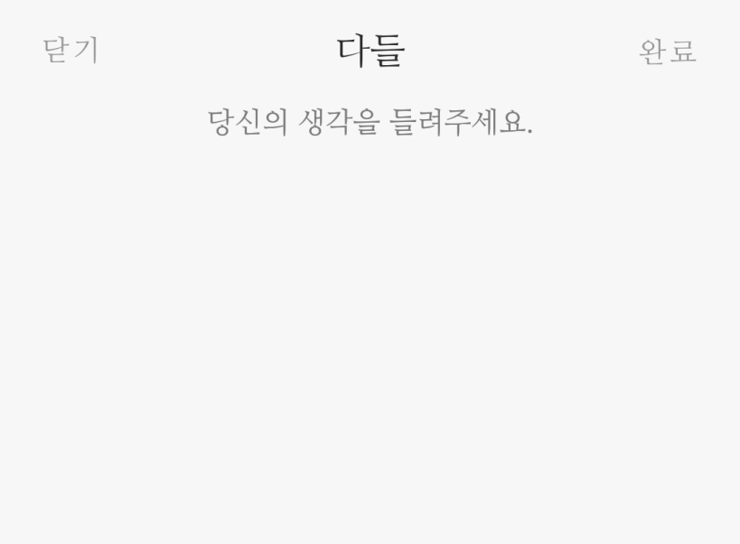
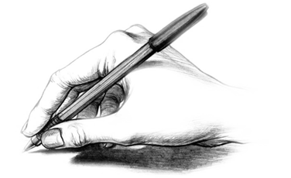
01.
Software description.
Calliwriting software is software for correcting handwriting and practicing calligraphy.

Slide 3
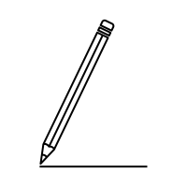

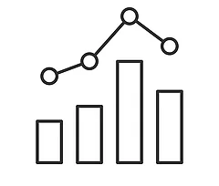
01.
Software description.
Practice sheet
Graph
feedback

Slide 4
02.
Software Demo video

Slide 5
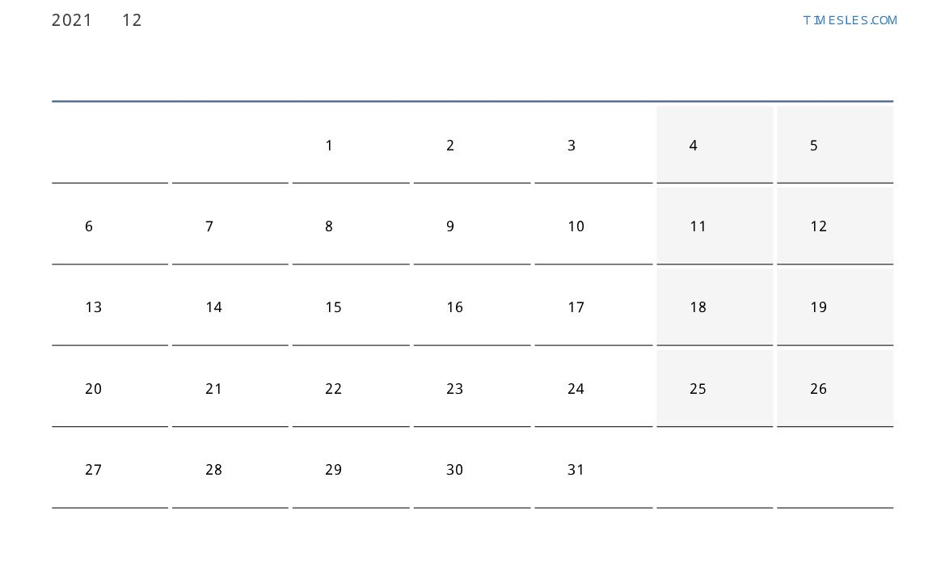
03.
Proposed Milestones and Achieved Steps
Real-time image loading
Font addition
Ui Implement
Subdivided feedback
+) Graph implementation
+) Ui Progress

Slide 6
Division of roles
04.
〮 Create study paper 〮 Real-time image loading 〮 UI implementation
Park Yikyung
Developer Ui Designer
〮 Feedback implementation 〮 Graph implementation 〮 UI implementation
Kim Donghee
Developer Ui Designer

Slide 7
05.
Open Source Library Used
PyQt(GPL)
Cv2(Apache 2)
Textwrap (PSF)
calliwriting
Pillow(HPND)
Matplotlib(PSF)
Scikit-image(BSD)

Slide 8
06.
Open Source License Compatibility
 | GPL | Apache | MIT | BSD
GPL | O | O | O | O
Apache | O | O | O | O
MIT | O | O | O | O
BSD | O | O | O | O
+) HPND-GPL : Possible

Slide 9
07.
Open Source License for Calliwriting
Copyright (c) <2021> <Park Yikyung >
Permission is hereby granted, free of charge, to any person obtaining a copy of this software and associated documentation files (the "Software"), to deal in the Software without restriction, including without limitation the rights to use, copy, modify, merge, publish, distribute, sublicense, and/or sell copies of the Software, and to permit persons to whom the Software is furnished to do so, subject to the following conditions: The above copyright notice and this permission notice shall be included in all copies or substantial portions of the Software. THE SOFTWARE IS PROVIDED "AS IS", WITHOUT WARRANTY OF ANY KIND, EXPRESS OR IMPLIED, INCLUDING BUT NOT LIMITED TO THE WARRANTIES OF MERCHANTABILITY, FITNESS FOR A PARTICULAR PURPOSE AND NONINFRINGEMENT. IN NO EVENT SHALL THE AUTHORS OR COPYRIGHT HOLDERS BE LIABLE FOR ANY CLAIM, DAMAGES OR OTHER LIABILITY, WHETHER IN AN ACTION OF CONTRACT, TORT OR OTHERWISE, ARISING FROM, OUT OF OR IN CONNECTION WITH THE SOFTWARE OR THE USE OR OTHER DEALINGS IN THE SOFTWARE.
MIT License

Slide 10
Thank you

